Slide 1
“TM Water”

Slide 2

We Are Going To Discuss
Over View
Crucial Factors
Project Time Lines
Project Portfolio
Financial Summary
The Process Flow
Strategic Recommendations
Key Success Factors
Sector And Industry Analysis
Brand Available In The Market
Machinery & Equipment Requirement
HR Requirement
Land & Building Requirement
Financial Assumption
Key Assumption
Financial Statement

Slide 3
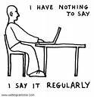
Introduction & Overview
We are going to launch TM water, a mineral bottled water in Pakistan.
The objective of the pre-feasibility study is primarily to facilitate potential entrepreneurships in project identification for investment.

Slide 4
Definition of The Business
Water treatments include:
Distillation. In this process, water is turned into a vapor. Since minerals are too heavy to vaporize, they are left behind, and the vapors are condensed into water again.
Reverse osmosis. Water is forced through membranes to remove minerals in the water.
Absolute 1 micron filtration. Water flows through filters that remove particles larger than one micron in size, such as Cryptosporidium, a parasitic protozoan.
Ozonation. Bottlers of all types of waters typically use ozone gas, an antimicrobial agent, to disinfect the water instead of chlorine, since chlorine can leave residual taste and odor to the water.

Slide 5

Crucial Factors
The market for purified bottled / mineral water is a growing market, but offers tough competition.
Perception / positioning of the new brand. Usually the top target market for bottled mineral water follows the perception. If the perception is positive, the results will be higher sales. The positive perception for distributors and final customers may result from direct consumer experience, awareness, direct promotional activities, print media and TV advertising.
Distribution is very important for the success of new brand. The stronger the distribution the more successful will be the new brand. The distribution strategy should be designed after a careful study of the market for going for regional distribution or for nation wide distribution.

Slide 6
Pre-launch advertising is vital for positive perception of the product, which will result in higher product acceptance.
Compliance of the water quality standards of Pakistan Standards & Quality Control Authority (PSQCA) and license from the authority.
Availability of product at A class, B class or C class shops should be decided before launching the product and availability should be persistent.

Slide 7
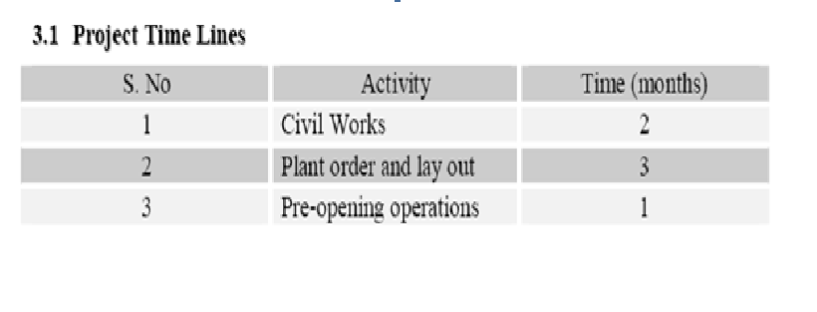
Project Time Lines

Slide 8

Project Portfolio
Purification of Water.
Project Brief.
Project Investment.
Process.
Project Capacity Rationale.
Proposed Product Mix.
Financial Summary.
The process flow.
Proposed Location.

Slide 9
Purification Of Water
Purified Bottled Water.
A process for the production of bacteria free, clean and palatable bottled water.
The plant was put into process in 1987.

Slide 10
Project Brief
This proposed project presents an investment opportunity for establishing a bottled water plant for providing pure drinking water. The proposed product line will consist of Bottles of 1.5 and 0.5 liters. In the initial phase of the project only 0.5 liters and 1.5 liters bottles will be introduced in the local market. After successful introduction of the new brand of bottled water the product line may be extended to 13 and 19 liters cans.

Slide 11
Project Investment
The total cost of the project has been worked out to be Rs.15.066 million.
This includes a fixed cost of Rs.11.485 million and a working capital requirement of Rs.3.580 million.
Period of construction is 2 months for civil works and 3 months for machinery & Equipment layout and installation.

Slide 12
Process
Two sources of water can be used for purification purposes on commercial basis,
Ground Water.
Water Supply from KWSB (in Karachi).

Slide 13
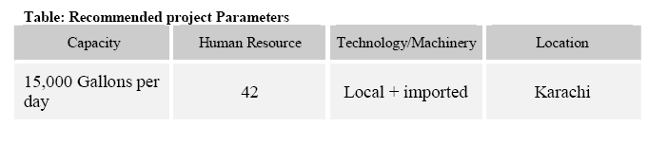
Proposed Product Mix
This feasibility has been developed for a water purification plant with a capacity of 15,000 gallons per day. The product mix consists of water bottles of 1.5 liters and 0.5 liter in the ratio of 80% and 20% respectively.

Slide 14
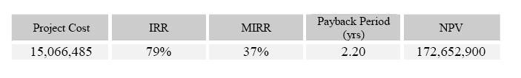
Financial Summary
The financial cost of the project can be summarized as under:

Slide 15
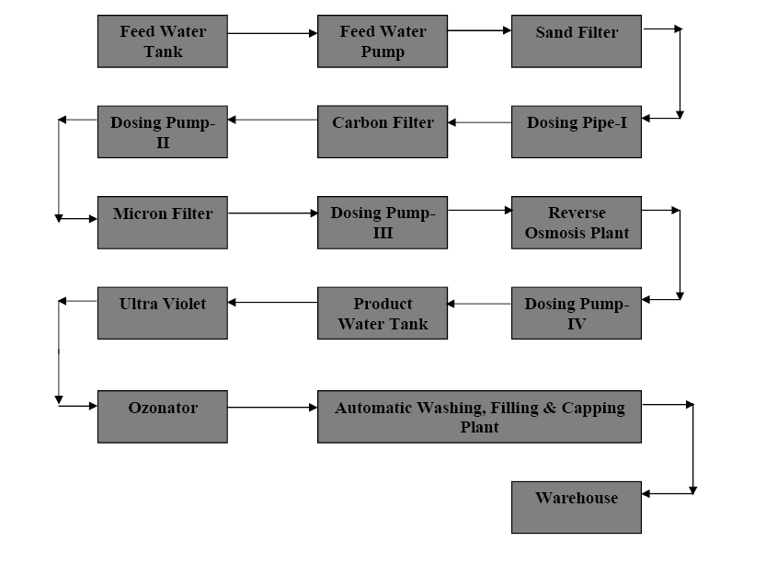
The Process Flow

Slide 16

Proposed Location
Any industrial area in Karachi where KWSB water is easily available is ideal for this project.

Slide 17


Strategic Recommendations
Market Entering Time
The weather is the main dynamic that may bring changes in the market size of the purified drinking water as the daily water requirement increases in summer.
The advertisement including TV and print media is expected to bring changes in the demand.

Slide 18
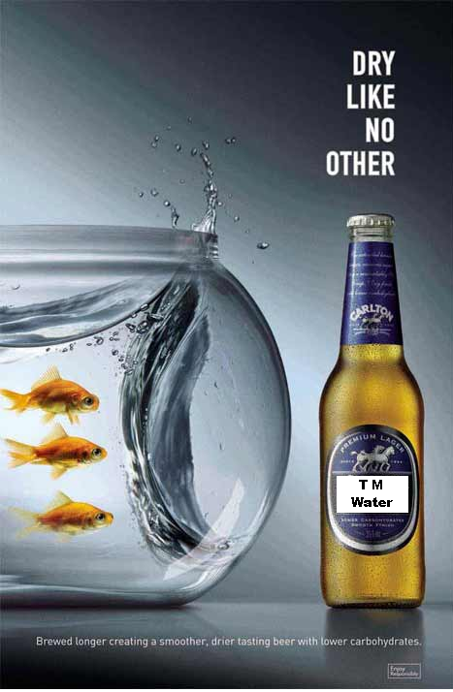
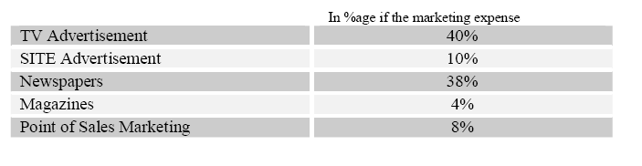
Key Success Factor
Marketing.
Pricing.
Product Packaging.

Slide 19
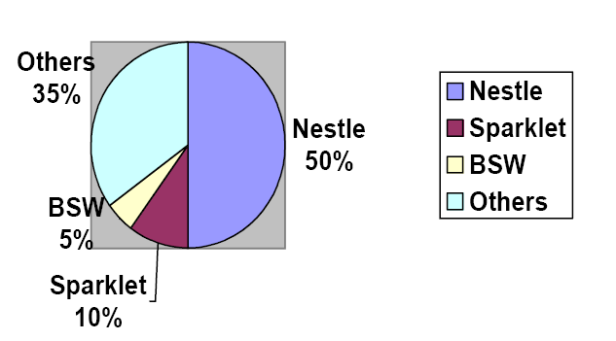

Sector And Industry Analysis
There are around 26 players in the bottled water sector.
Pakistan’s bottled water market comprises of two main segments i.e. retail market and bulk market.
The retail market consists of 0.5 liter, 1.5 liter, 3.1 liter and 5.0 liter capacity PET bottles.
The bulk market consist s of home and office delivers in 3 and 5 gallon cans.

Slide 20
Brand Available In The Market
Niagra
Nestle Pure
AVA
Sparklets
Masafi
Aqua Safe
Cool
Ab-e-Hayat
Rainbow
Pearl
Asakari
Safa
Zam Zam
Fresh
Musaffa
Mineral Plus
Aqua Flow
Max Wellpur
Himalaya
Brecorn Carreg
Evian
Perrier
Oslo
Vital
Classic
Blue ever pure
Jeema
Vittel
Gulfa
Volvic
Highland Spring
SPA
Hayat
Wellgreen

Slide 21
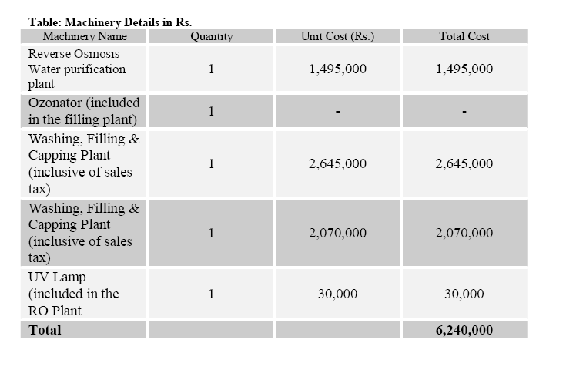
Machinery & Equipment Requirement
Most of the water purification plants being installed in the country are reverse osmosis based.

Slide 22
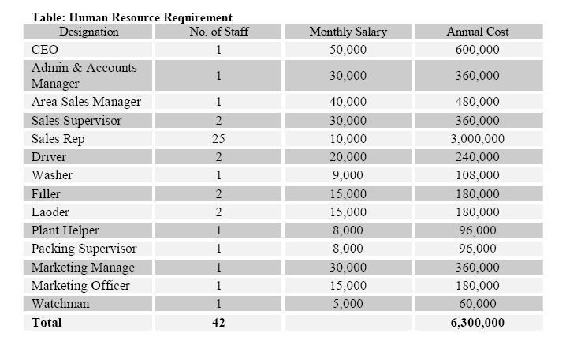
HR Requirement

Slide 23
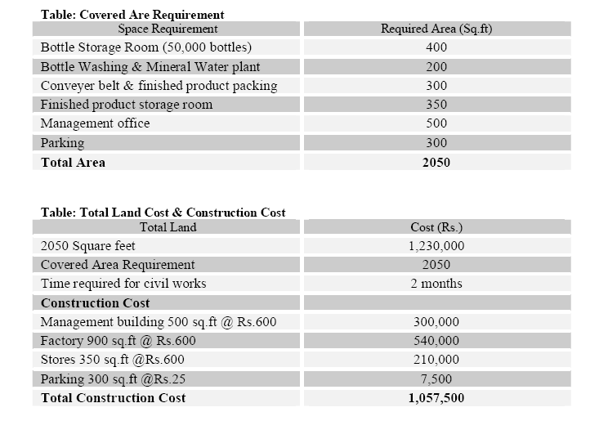
Land & Building Requirement
For the proposed set up of water purification plant, a total of 2050 square feet is required.

Slide 24
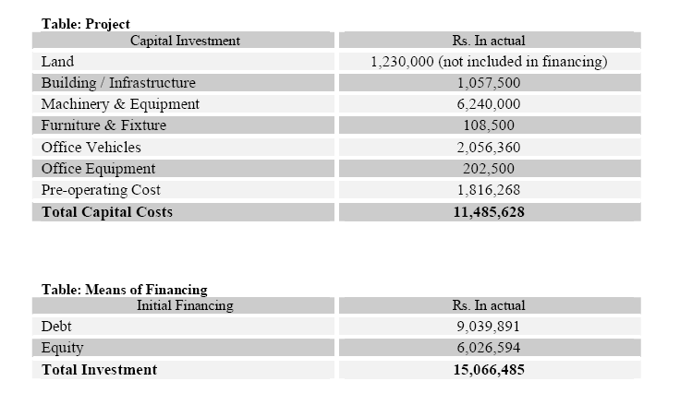
Financial Assumption

Slide 25
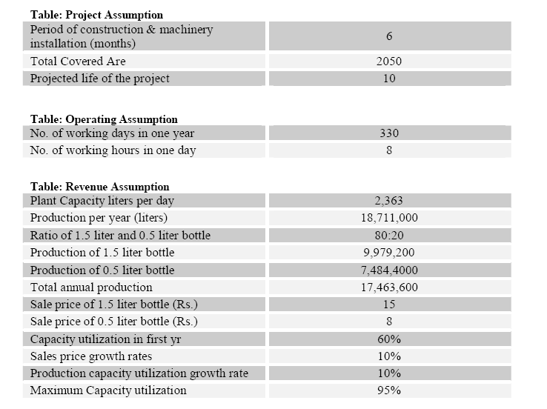
Key Assumption

Slide 26
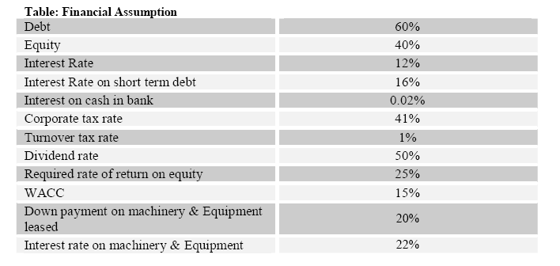

Slide 27
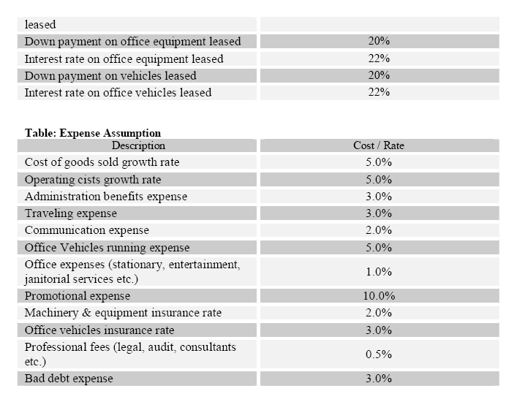

Slide 28
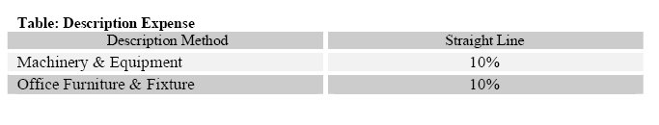

Slide 29
Financial Statement
Projected Income Statement.
Projected Balance Sheet.
Projected Cash Flow Statement.

Slide 30
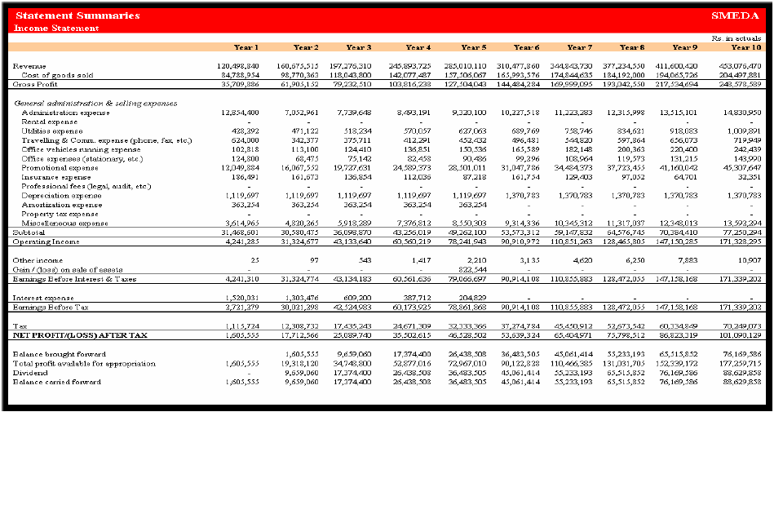
Projected Income Statement

Slide 31
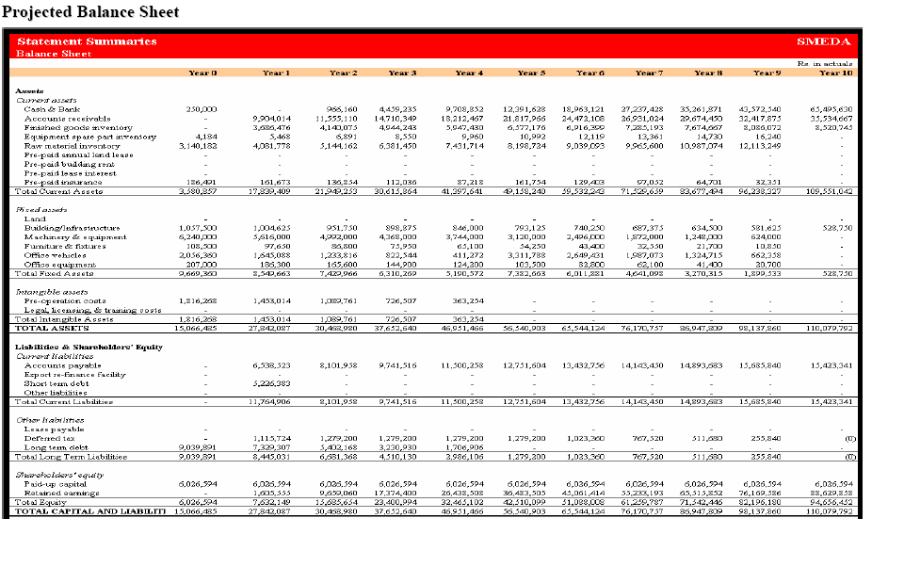
Projected Balance Sheet

Slide 32
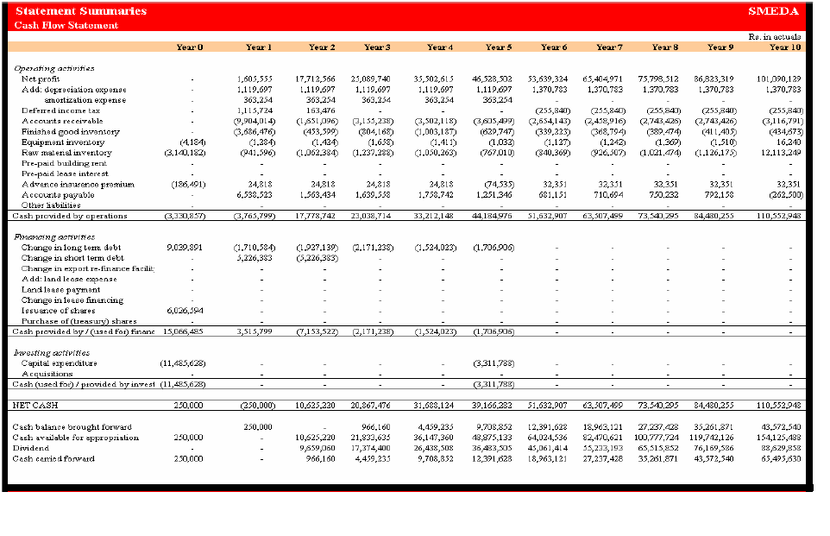
Projected Cash Flow Statement

